Slide 1
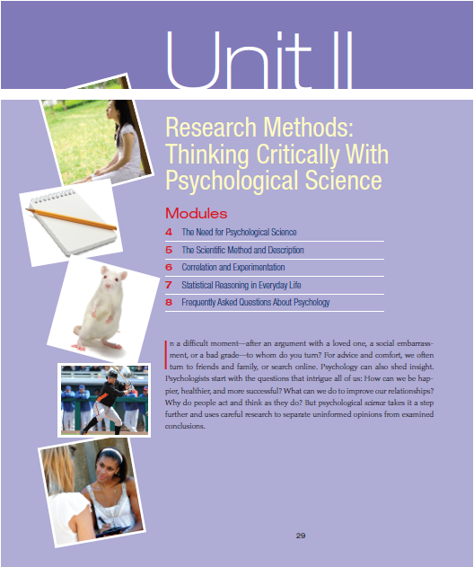
Unit 2: Research Methods

Slide 2
Module 04: The Need for Psychological Science

Slide 4
Errors of Common Sense
Try this !
Fold a piece of paper (0.1 mm thick) 100 times. How thick will it be?
800,000,000,000,000 times the distance between the sun and the earth.

Slide 5
The Scientific Attitude: Curious, Skeptical and Humble
Three main components
Curious eagerness
Skeptically scrutinize competing ideas
Open-minded humility before nature
Hindsight bias, overconfidence and our tendency to perceive patters in random events often lead us to overestimate our intuition.

Slide 6
Critical Thinking
Critical Thinking
“Smart thinking”
Elements
Examines assumptions
Assesses the source
Discerns hidden values
Confirms evidence
Assesses conclusions

Slide 8
The Scientific Method
Theory
“mere hunch”
Hypothesis
Can be confirmed or refuted
Operational Definition
Replication (repeat)

Slide 9
The Scientific Method
A good theory is useful if it:
Effectively organizes a range of self-reports and observations
Leads to clear hypotheses (predictions) that anyone can use to check the theory
Often stimulates research that leads to a revised theory which better predicts what we know

Slide 10
Description

Slide 11
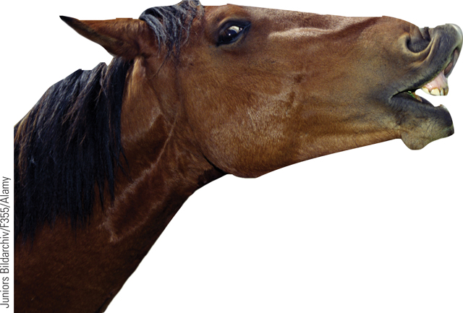
Description The Case Study
Case Study
Hope to reveal universal truths
Problems with atypical individuals
Cannot discern general truths

Slide 12
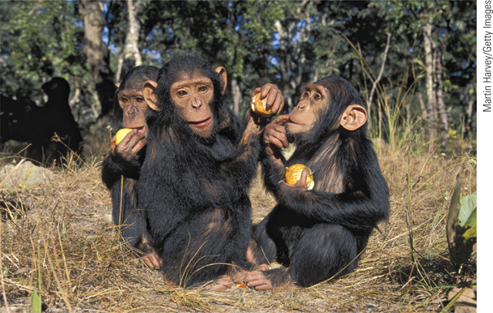
Description Naturalistic Observation
Naturalistic Observation
Describes behavior
Does not explain behavior

Slide 13
Description The Survey
Survey
Looks at many cases at once
Word effects
Random sampling
Representative sample
Sampling bias

Slide 14
Survey
Random Sampling
If each member of a population has an equal chance of inclusion into a sample, it is called a random sample (unbiased). If the survey sample is biased, its results are not valid.
The fastest way to know about the marble color ratio is to blindly transfer a few into a smaller jar and count them.

Slide 15
Description The Survey
Sampling
Population
Random Sample

Slide 17
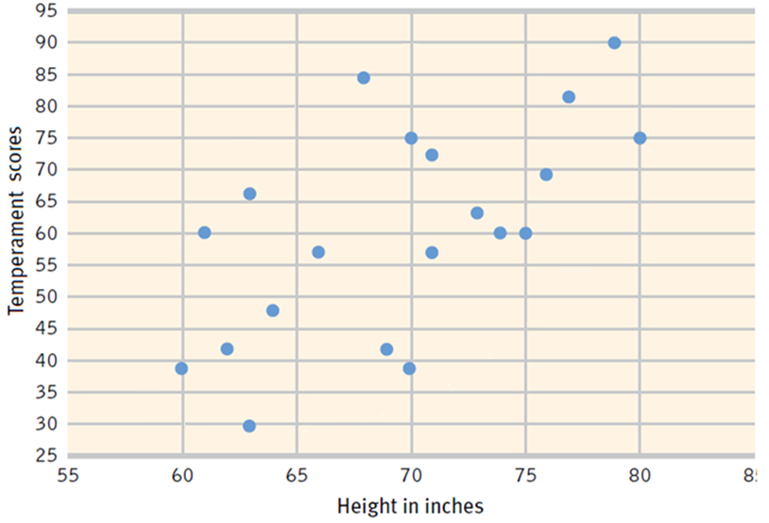
Correlation
Correlation (correlation coefficient)
How well does A predict B
Positive versus negative correlation
Strength of the correlation
-1.0 to +1.0
Scatterplot

Slide 18
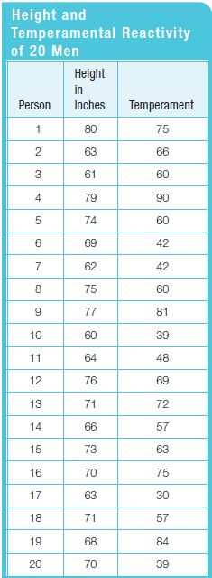
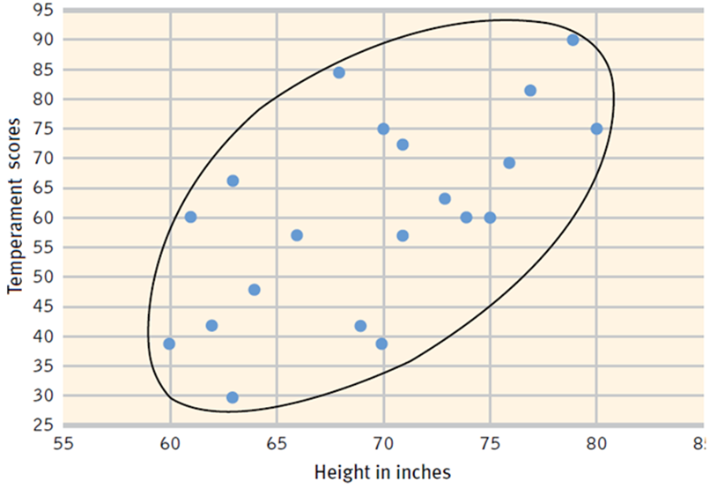
Correlation

Slide 19
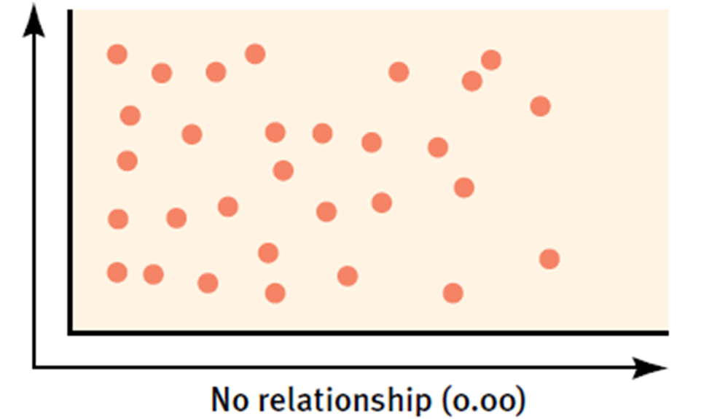
Correlation

Slide 20
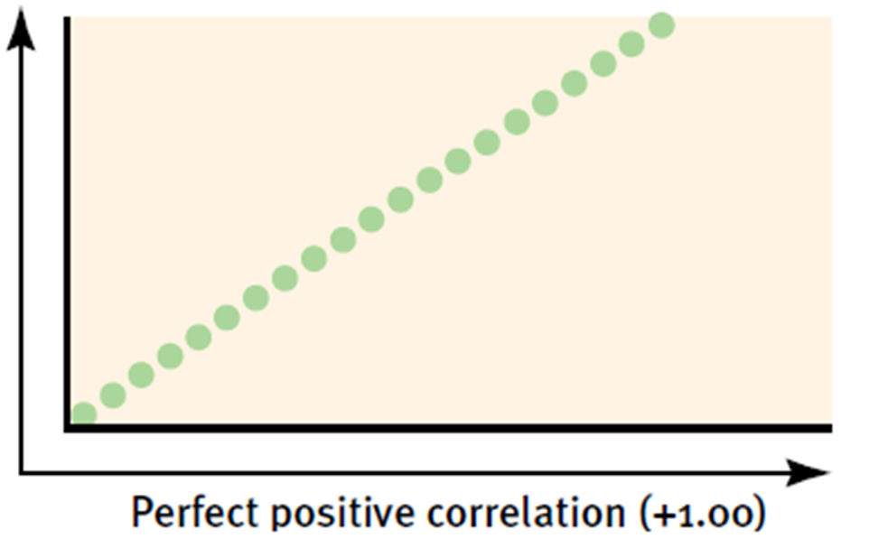
Correlation

Slide 21
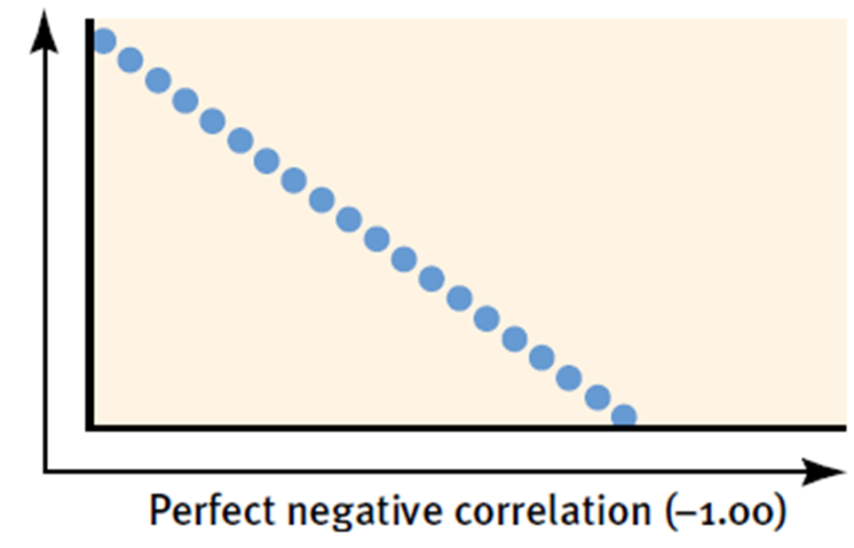
Correlation

Slide 22
Correlation Correlation and Causation
Correlation helps predict
Does not imply cause and effect

Slide 23
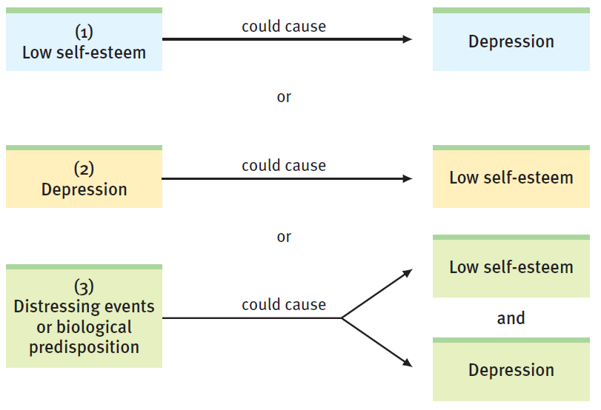

Slide 24
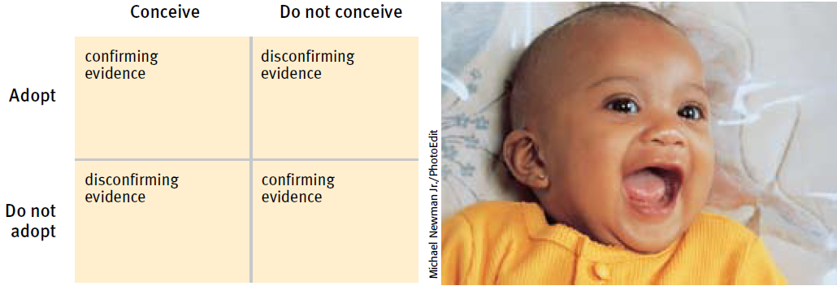
Correlation Illusory Correlations
Illusory Correlation
Perceived non-existent correlation
A random coincidence

Slide 25
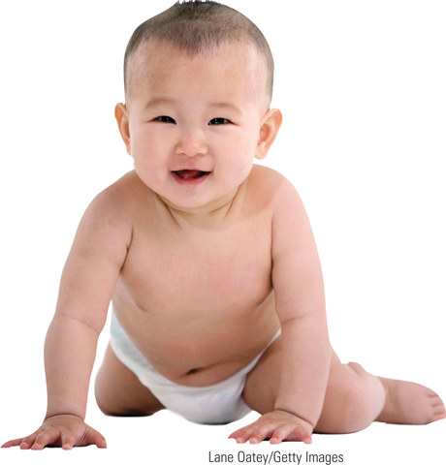
Experimentation
Experiment
Can isolate cause and effect
Control of factors
Manipulation the factor (s) of interest
Hold constant (“controlling”) factors

Slide 26
Experimentation
Groups
Experimental Group
Receives the treatment (independent variable)
Control Group
Does not receive the treatment

Slide 27
Experimentation
Randomly assigned
Eliminates alternative explanations
Equalizes the two groups
Reduces the influence of other (confounding variables)
Different from random sample

Slide 28
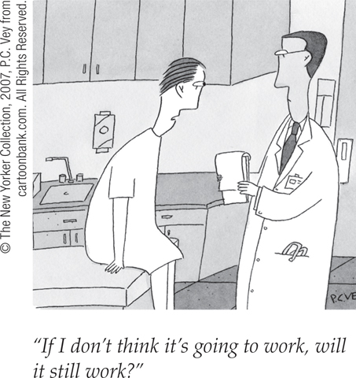
Experimentation
Blind (uninformed)
Single-Blind Procedure
Double-Blind Procedure
Placebo Effect

Slide 29
Experimentation Independent and Dependent Variables
Independent Variable
Confounding variable
Effect of random assignment on confounding variables
Dependent Variable
What is being measured
Validity

Slide 30
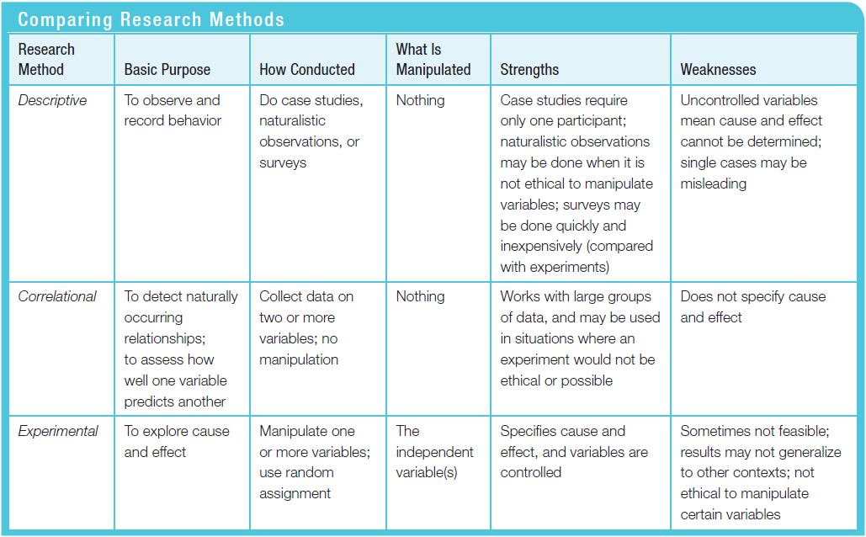
Comparing Research Methods

Slide 31
Next Zoom Meeting
Thursday April 16 12:30
Have completed
Assigned reading – On class website - kssmcconnell.weebly.com
Assigned Unit 1 Free Response Question – on MyAP Site
Research Methods review video from the CollegeBoard
https://www.youtube.com/watch?v=kQUT9OgF1Xo&list=PLoGgviqq4844U91iotDP7n7brR_ovoSFB&index=6
Recommend watching at faster speed, slow down, take notes, re-watch parts that you are not sure about.

Slide 33
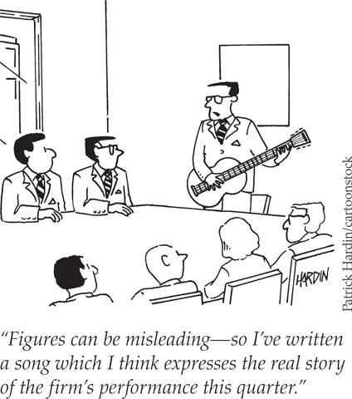
The Need for Statistics
Understanding basic statistics is beneficial for everyone

Slide 34
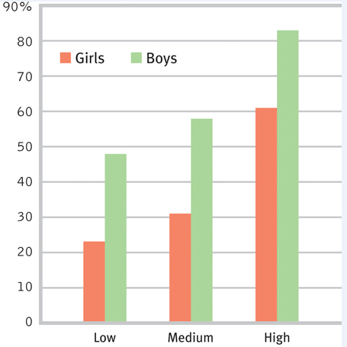
Descriptive Statistics
Descriptive Statistics
Histogram (bar graph)
Scale labels

Slide 35
Descriptive Statistics Measures of Central Tendency
Mean (arithmetic average)
Median (middle score)
Mode (occurs the most)
Skewed distribution

Slide 36
Descriptive Statistics Measures of Variability
Range
Standard Deviation

Slide 37
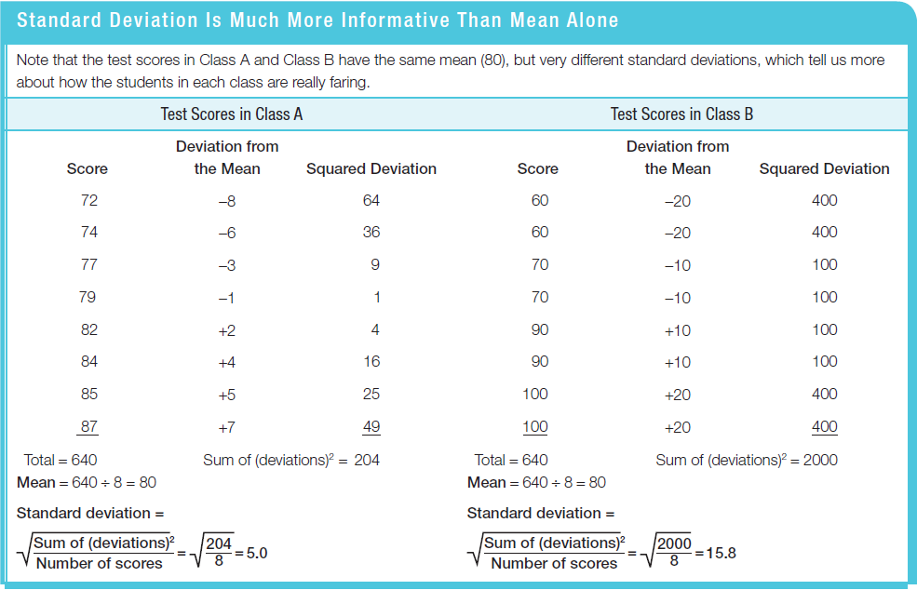
Standard Deviation

Slide 38
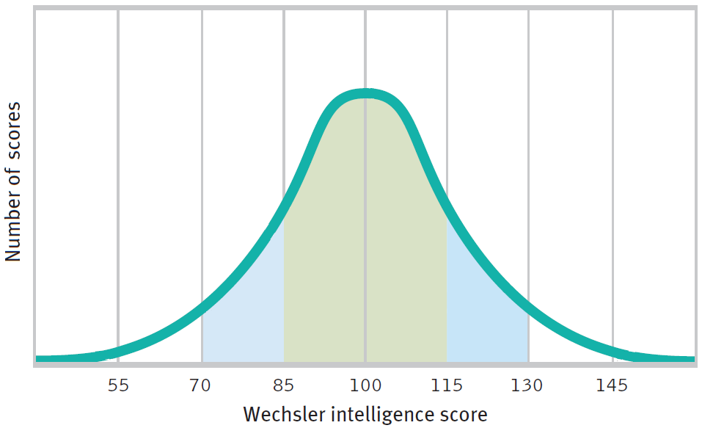
Descriptive Statistics Measures of Variability
Normal Curve (bell shaped)

Slide 39
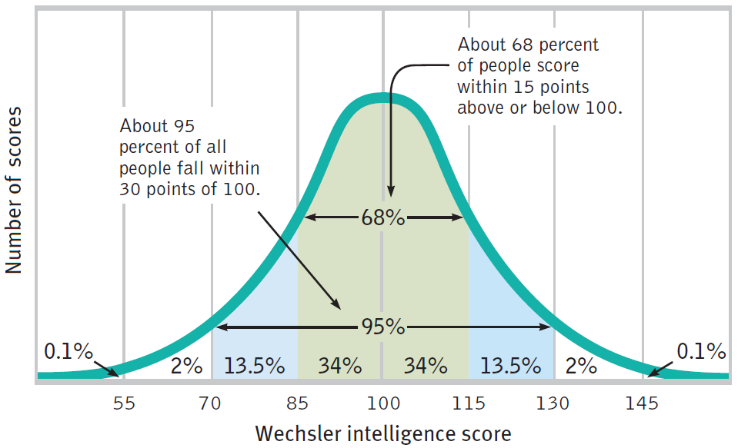
Descriptive Statistics Measures of Variability
Normal Curve

Slide 40
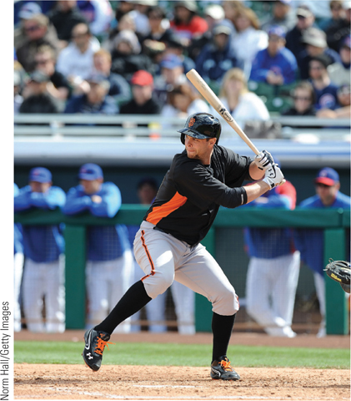
Inferential Statistics

Slide 41
Inferential Statistics When Is an Observed Difference Reliable?
Inferential statistics
Representative samples are better than biased samples
Less-variable observations are more reliable than those that are more variable
More cases are better than fewer

Slide 42
Inferential Statistics When Is a Difference Significant?
Statistical significance
The averages are reliable
The differences between averages is relatively large
Does imply the importance of the results

Slide 44
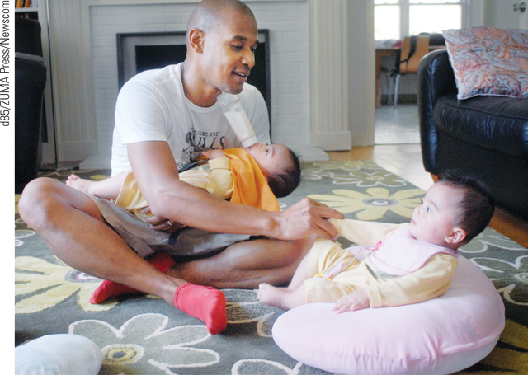
Psychology Applied
Can laboratory experiments illuminate everyday life?
The principles, not the research findings, help explain behavior
Does behavior depend on one’s culture and gender?
Culture
Gender

Slide 45
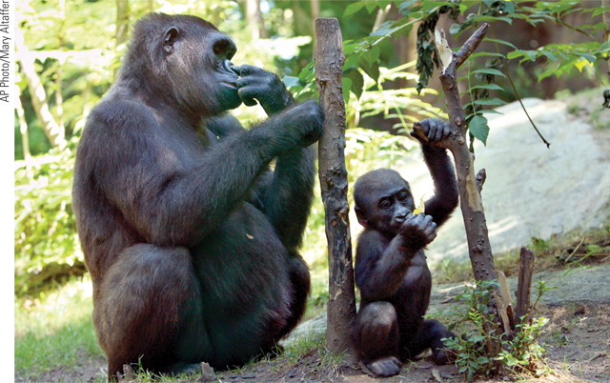
Ethics in Research
Ethics in animal research
Reasons for using animals in research
Safeguards for animal use

Slide 46
Ethics in Research
Ethics in human research
Informed consent
Protect from harm and discomfort
Maintain confidentiality
Debriefing

