Slide 1
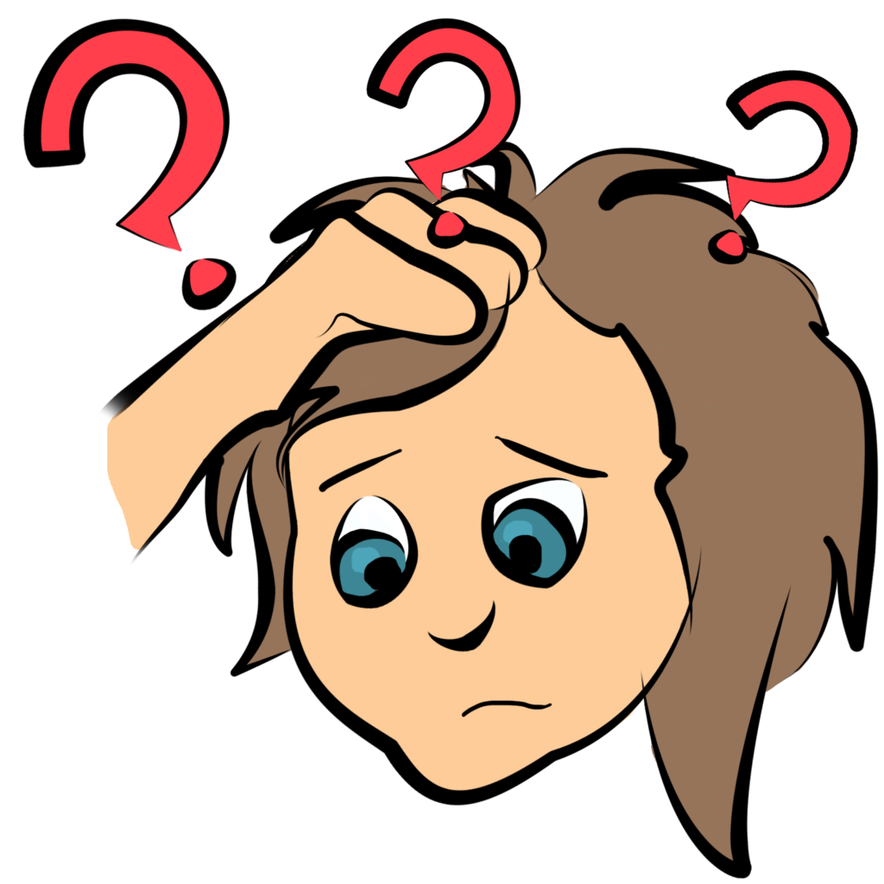
Psychology AP Going Forward

Slide 2
Checking in
Strange times
Stressful
Biggest concerns
Something good

Slide 3
Help Available
KSS Website for Mental Health
http://wellnesswhileathomekss.weebly.com/

Slide 4
Challenge
Learn one new life-skill this week
Ex. How to do an oil change, change a tire, learn to sew, knit,
learn a few phrases in a new language, etc.

Slide 5
Where’s McConnell been??

Slide 8
What’s Going on with Psychology ap
Those that paid will be getting some money back
There is free cancellation of exam for now
We will look at the revised exam, so you can make an informed decision what to do.

Slide 9
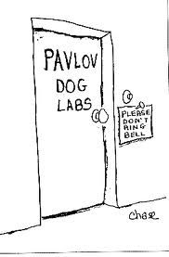
What’s Going on with Psychology AP
Reorganized units (been all this school year) https://apcentral.collegeboard.org/pdf/ap-psychology-course-a-glance.pdf?course=ap-psychology
AP Exam is only on Units 1 through 7
At home version of the test (45 minutes)
My understanding is it will be open book. They will be looking for the application of concepts. *** There is not enough time to look everything up!!
Don’t cheat, plagiarize etc. They will be using very sophisticated anti-cheating software

Slide 10
Exam Schedule & format
https://apcoronavirusupdates.collegeboard.org/educators/taking-the-exams/ap-exam-schedule
May 19 at 11:00 am
You can use computer, laptop, tablet, or smartphone. Make sure whatever you will be using is available and in working order.
You can even write it on paper, take a picture and upload it.

Slide 11
Some advice – If using a computer, or home network
Ethernet is better than WiFi
Reset your modem – It is only a matter of unplugging or turning off for a minute. Google how to do this. There is an order to the method. You could even do this the day before the test.
Good idea to clear your cache and restart your computer.
If you have access to backup data (like a phone hotspot) make sure you know how to use it.
If using WiFi the closer to your router the better.

Slide 12
Toughest Units You feel we need to review more?
What are you most worried about regarding the AP Exam
Biological Bases of Behaviour?
States of Consciousness?
Other?

Slide 13
What about units we have not done?
There are some topics we have not completed.
Will not be on the exam
They are important though as Universities and Colleges expect you know them.
I suggest we focus on test preparation. Once we are comfortable or after the Exam, we complete all the units.
What do you think? The information is already on YouTube on my channel.

Slide 14
Tools we will be using
Kssmcconnell.weebly.com
Google Classroom – Day 2 join code is oaffn6y – do it now
I will post links to these Zoom classes there.
Some practice testing and review assignments will probably be put on there as we go
AP Classroom
There will be questions assigned through here.
Advanced Placement YouTube Review Videos – Link https://www.youtube.com/user/advancedplacement

Slide 15
What do we do now?
Lets go back to the beginning
Before next Zoom class
Answer the Multiple Choice Questions assigned on your AP Classroom
Look at the AP YouTube Review video of Unit 1 https://www.youtube.com/watch?v=r_S0n1lrZww&list=PLoGgviqq4844U91iotDP7n7brR_ovoSFB&index=4
It may be helpful to have your notes from my video for this unit (I am so much better than this AP Lady! ☺). I suggest speeding up the video and pausing if you feel you need to add to your notes.
Answer the FRQ’s assigned through the AP Classroom

Slide 16
Next Zoom Meeting
Tuesday April 15 at 2:00
We will schedule for 1 hour, but will likely be shorter.
Bring your questions!

Slide 17
Miss you all! – We got this!!

