Slide 1
Unit 9: Developmental Psychology

Slide 2
Unit Overview
Prenatal Development and the Newborn
Infancy and Childhood
Parents and Peers
Adolescence
Adulthood
Reflections on Two Major Developmental Issues
Click on the any of the above hyperlinks to go to that section in the presentation.

Slide 3
Introduction
Developmental psychology
Nature versus nurture
Continuity and stages
Stability and change

Slide 4
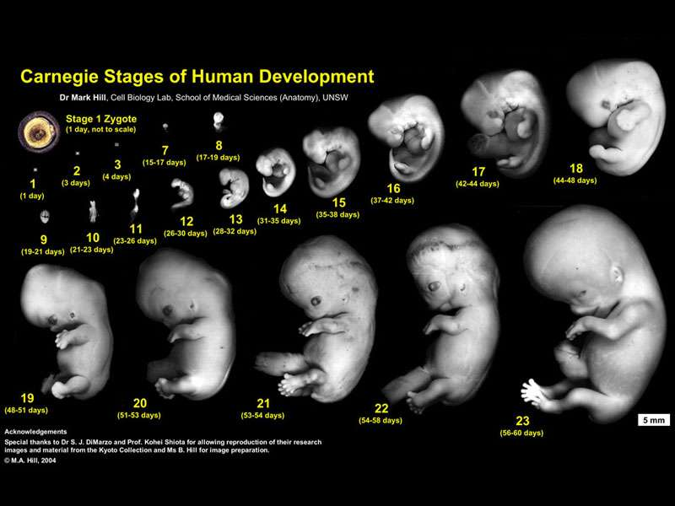
Prenatal Development and the Newborn

Slide 5
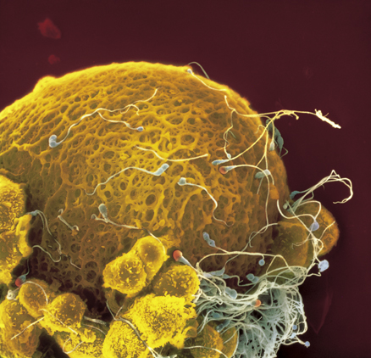
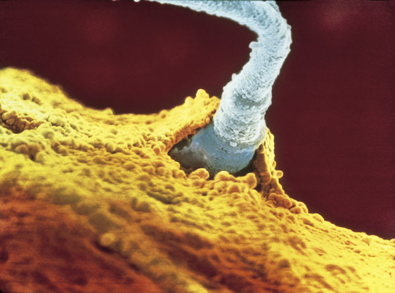
Conception
Conception

Slide 6
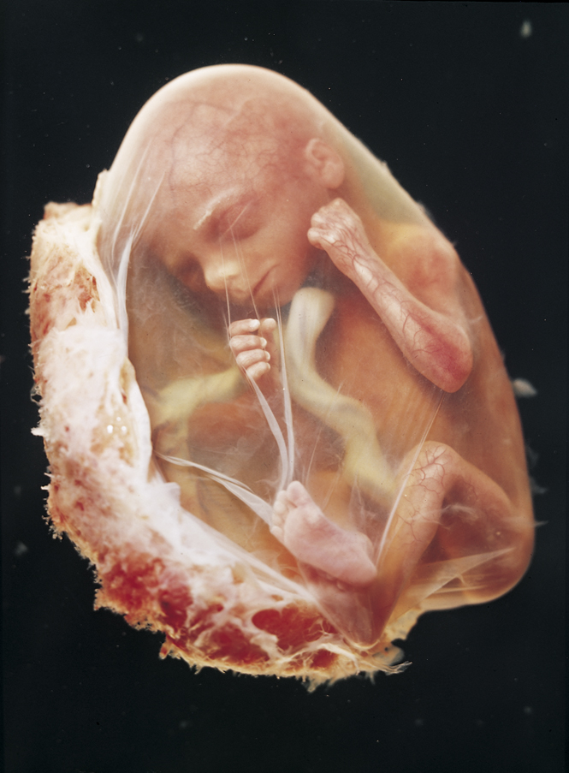
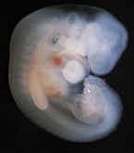
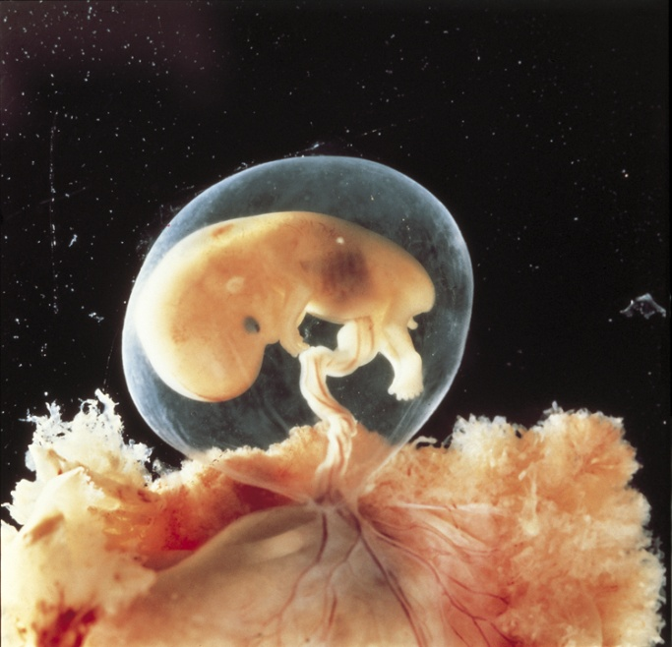
Prenatal Development
Zygote
Embryo
Fetus

Slide 7
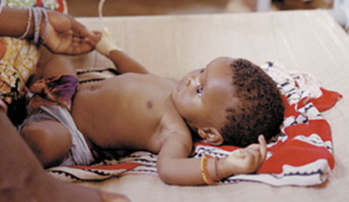
Prenatal Development
Placenta
Teratogens
Fetal alcohol syndrome (FAS)

Slide 8
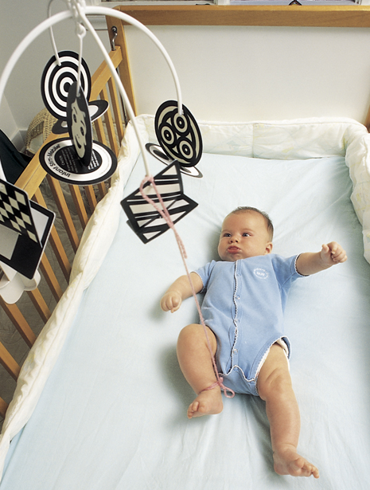
The Competent Newborn
Reflexes
Habituation
Novelty-preference procedure
Sensation and perception

Slide 9
What is the ideal age, and why?
What is the worst age to be, and why?

Slide 10
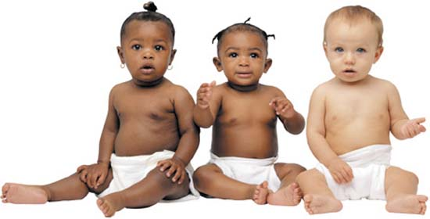
Infancy Childhood

Slide 11
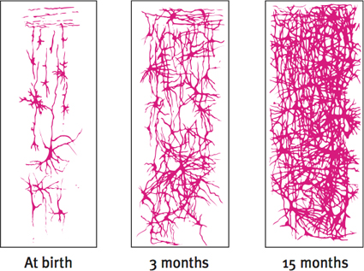
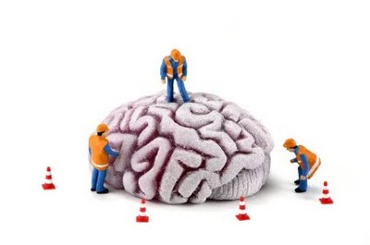
Physical Development Brain Development
Brain development
Pruning process
Maturation

Slide 12
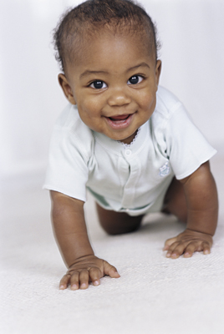
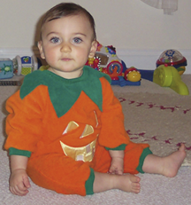
Physical Development Motor Development
Motor development
Learning to walk

Slide 13
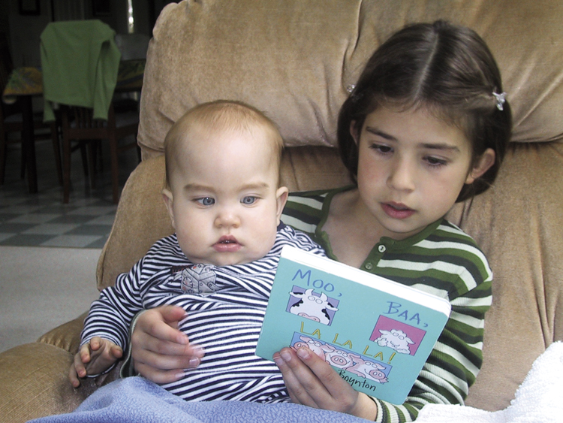
Physical Development Maturation and Infant Memory
Infantile amnesia

Slide 14
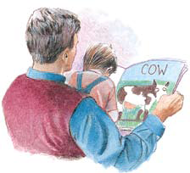
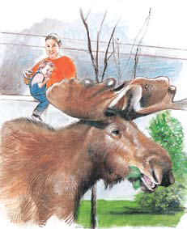
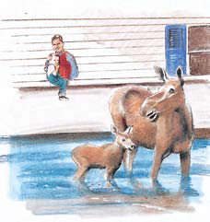
Cognitive Development
Cognition
Jean Piaget
Schema
Assimilation
Accommodation

Slide 15
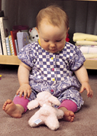
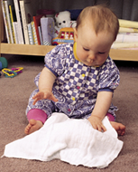
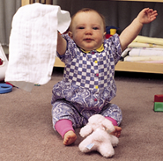
Cognitive Development Piaget’s Theory and Current Thinking
Sensorimotor Stage
Object permanence
“out of sight, out of mind”

Slide 16
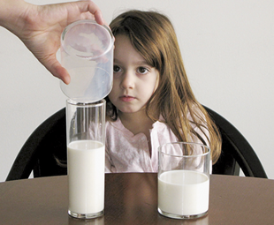
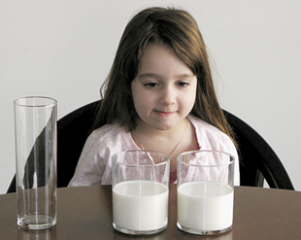
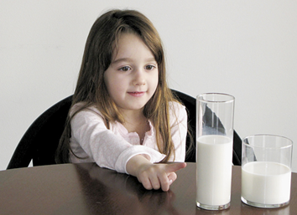
Cognitive Development Piaget’s Theory and Current Thinking
Preoperational Stage
Conservation

Slide 17
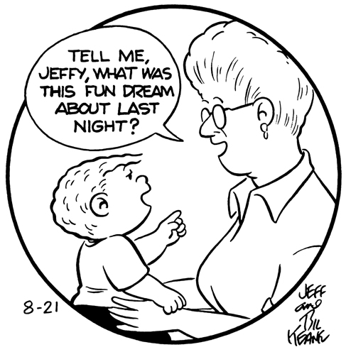
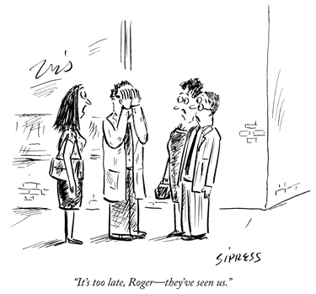
Cognitive Development Piaget’s Theory and Current Thinking
Egocentrism

Slide 18
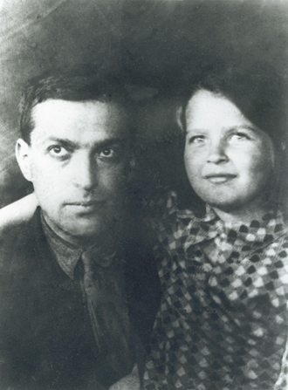
Cognitive Development Piaget’s Theory and Current Thinking
Theory of Mind
ability to infer others’ mental states

Slide 19
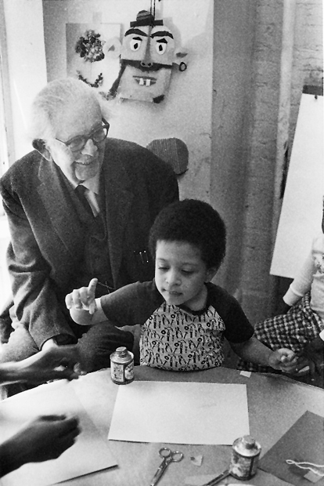
Cognitive Development Piaget’s Theory and Current Thinking
Concrete Operational Stage

Slide 20
Cognitive Development Piaget’s Theory and Current Thinking
Formal Operational Stage
Abstract concepts

Slide 21
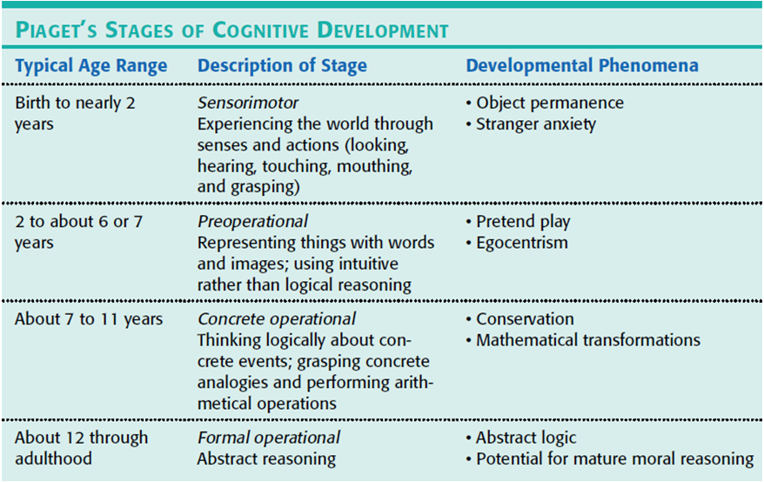
Cognitive Development Piaget’s Theory and Current Thinking

Slide 22
Cognitive Development Reflecting on Piaget’s Theory
Influential theory
Development is more continuous
Larger emphasis on social factors

Slide 23
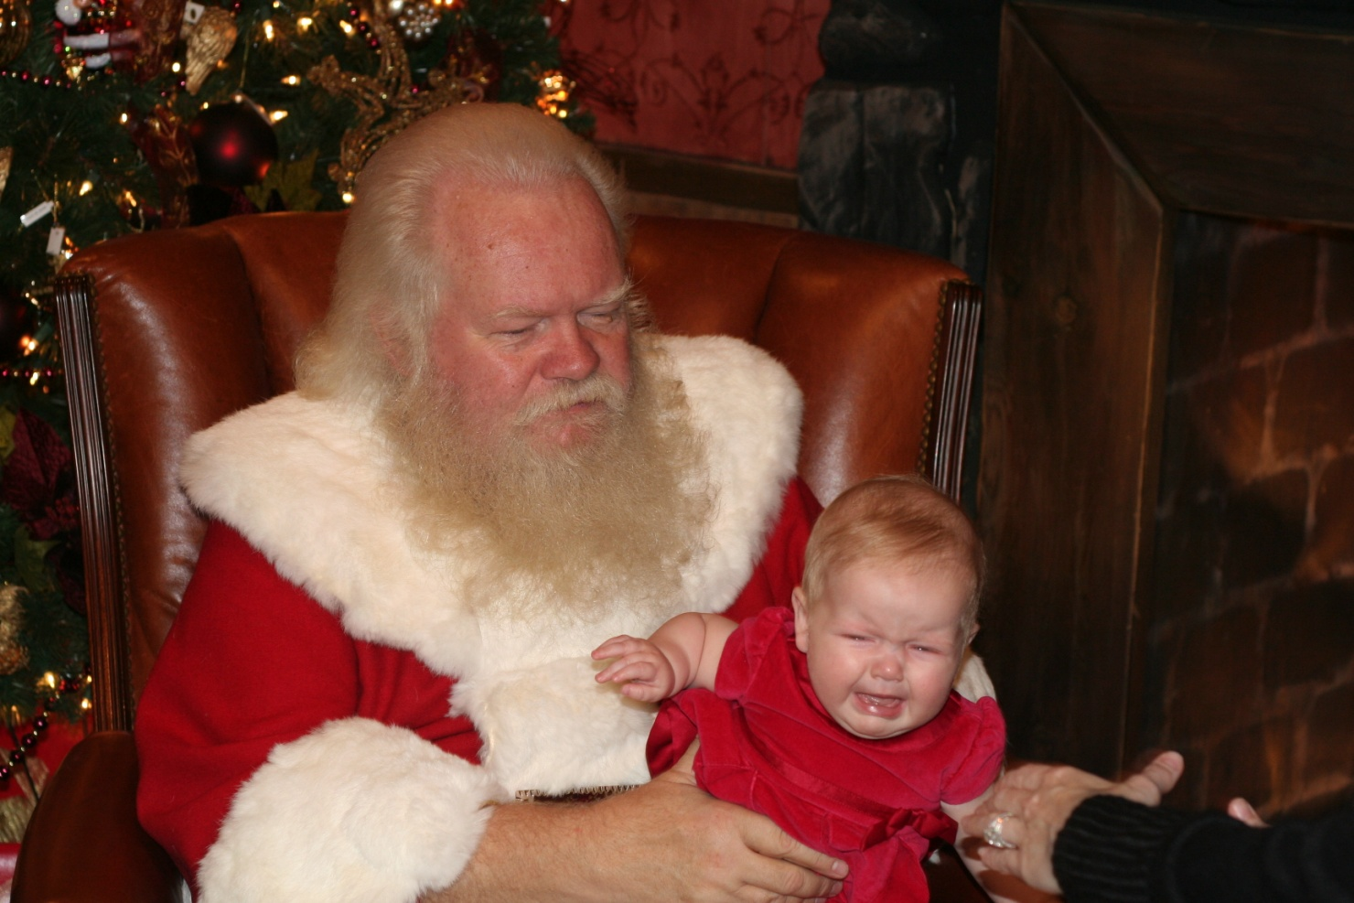
Social Development
Stranger anxiety

Slide 24
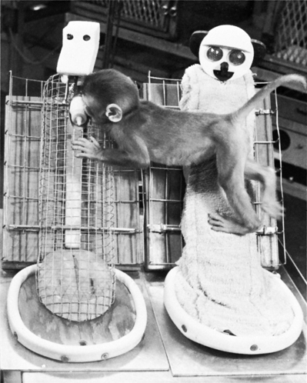
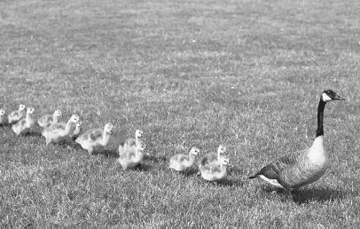
Social Development Origins of Attachment
Attachment
Body contact
Harry Harlow’s studies
Familiarity
Critical period
Imprinting
Sensitive period

Slide 25
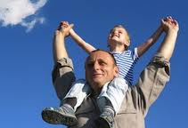
Social Development Attachment Differences: Temperament and Parenting
Ainsworth’s “strange situation”
Secure attachment
Insecure attachment

Slide 26
Social Development Attachment Differences: Temperament and Parenting
Temperament
Erikson’s Basic trust

Slide 27
Social Development Deprivation of Attachment
Early deprivation of attachment
Disruption of attachment
Does day care affect attachment?

Slide 28
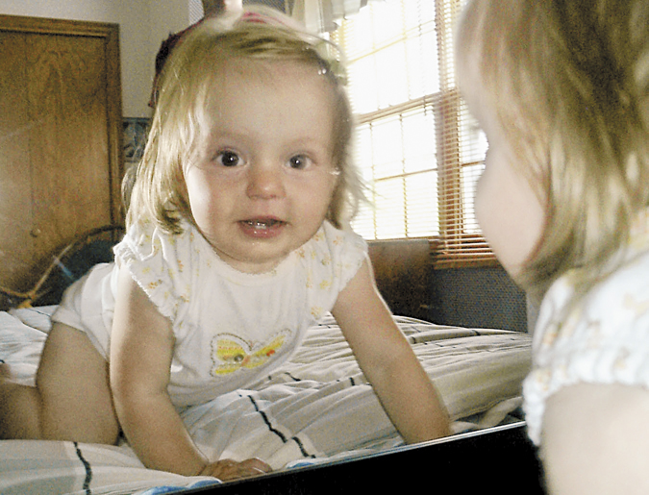
Social Development Self-Concept
Self-concept
Self-esteem
Self-awareness

Slide 29
Parenting Styles
Are your parents:
Overbearing or uninvolved?
Overprotective or distant?
Strict or permissive?

Slide 30
Social Development Parenting Styles
Parenting styles (Baumrind)
Authoritarian
Permissive
Authoritative
Correlation versus causation

Slide 31
Social Development Gender and Child-Rearing
What would you do if you saw your 3 year old son playing with Barbie dolls and wearing a princess dress?
What would you do if you saw your 3 year old daughter playing with Tonka trucks and Star Wars toys?

Slide 32
Gender Development
Gender
Influences on social development

Slide 33
Gender Development Gender Similarities and Differences
Gender and aggression
Aggression
Physical versus relational aggression
Gender and social power
Gender and social connectedness

Slide 34
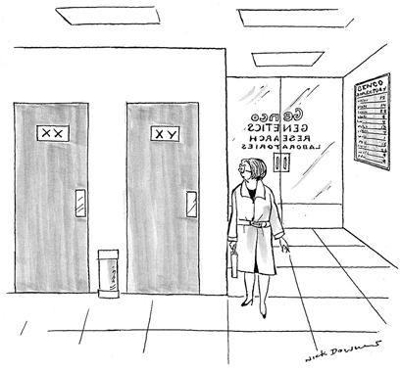
Gender Development The Nature of Gender
Sex chromosomes
X chromosome
Y chromosome
Sex hormones
Testosterone

Slide 35
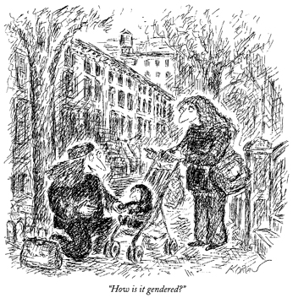
Gender Development The Nurture of Gender
Gender Role
Role
Gender and child -rearing
Gender identity
Gender typing
Social learning theory

Slide 36
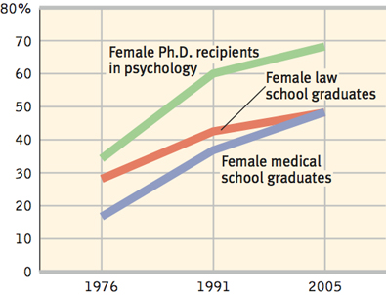
Gender Development The Nurture of Gender

Slide 37
Parents and Peers

Slide 38
Parental Influences
How much of an influence do your parents have on:
Your activities?
Your religious views?
Your musical interests?
Your political views?
Your style of dress?
Your peer groups?
Your career choice?

Slide 39
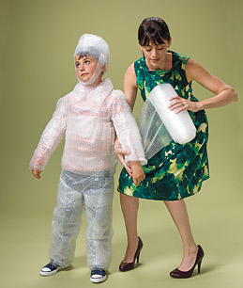
Parents and Early Experiences
How much credit (or blame) do parents deserve?

Slide 40
Peer Influence
How much do your friends influence:
Your activities?
Your religious views?
Your musical interests?
Your political views?
Your style of dress?
Your career choice?

Slide 41
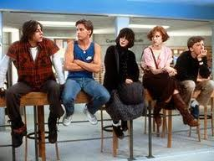
Peer Influence
Peer influence

Slide 42
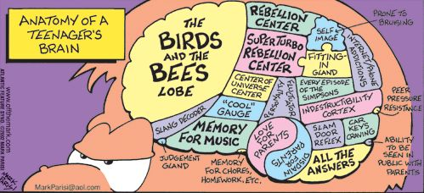
Adolescence

Slide 43
Introduction
Adolescence

Slide 44
Physical Development
Puberty
Primary sexual characteristics
menarche
Secondary sexual characteristics
Timing of sexual characteristics

Slide 45
Cognitive Development Developing Reasoning Power
Piaget’s formal operations

Slide 46
Cognitive Development Developing Morality
Lawrence Kohlberg
Preconventional morality
Conventional morality
Postconventional morality
Moral feeling
Moral action

Slide 47
Preconventional Morality
1. Avoids punishment—“Heinz will go to jail if he steals the drug.”
2. Gains rewards—“Heinz will have someone to fix fine dinners for him if his wife lives.”
Conventional Morality
3. Gains approval/avoids disapproval—“What would people think of Heinz if he lets his wife die?”
4. Does duty to support society/avoids dishonor or guilt—“Heinz must live up to his marriage vow of protecting his wife.”
Postconventional Morality
5. Affirms agreed-upon rights—“Everyone agrees that people have the right to live.”
6. Abstract, autonomous moral principle—“Saving a life takes precedence over everything else, including the law.”

Slide 48
How can you tell that someone is your friend?

Slide 49
You and your friends found a sheet of paper that
your teacher must have lost. On the paper are the
questions and answers for a test that you are going
to have tomorrow. Your friends all plan to study
from it, and they want you to go along with them.
You don’t think you should, but they tell you to do
it anyway. What would you really do: study from
the paper or not study from it?

Slide 51
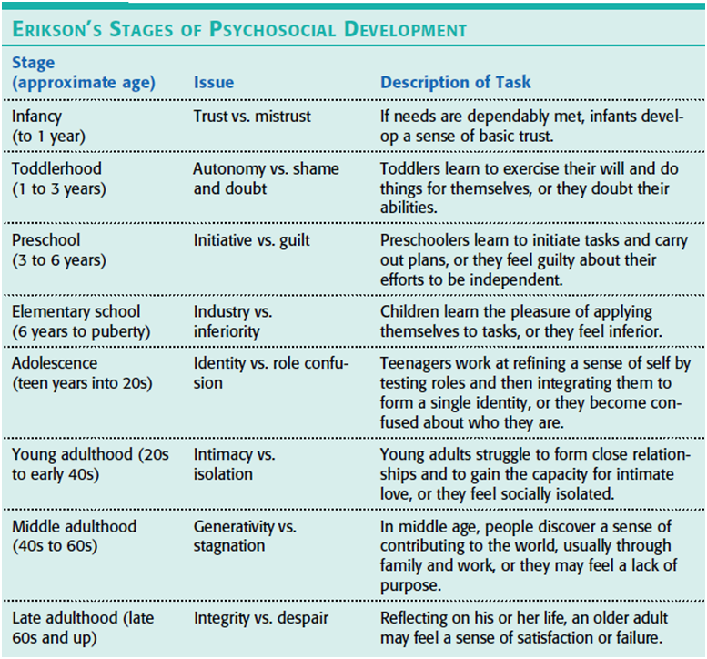

Slide 52
Social Development
Forming an identity
Identity
Social identity
Intimacy
Parent and peer relationships

Slide 53
Emerging Adulthood
Emerging adulthood
How would you define adulthood?

Slide 54
Adulthood

Slide 55
Adulthood
WHAT ARE YOUR TEN BUCKET LIST ITEMS?

Slide 56
Physical Development
Physical changes in middle adulthood
Menopause
Physical changes in later life
Life expectancy
Sensory abilities
Health
Dementia and Alzheimer’s Disease

Slide 57
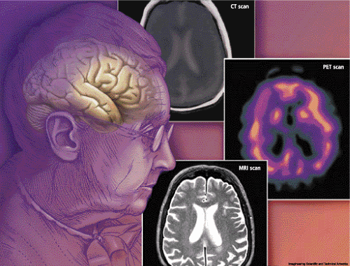
Cognitive Development Aging and Memory
Recall versus recognition
Prospective memory

Slide 58
Cognitive Development Aging and Intelligence
Cross-Sectional Evidence
Cross-sectional study
Longitudinal Evidence
Longitudinal study
It all depends
Crystallized intelligence
Fluid intelligence

Slide 59
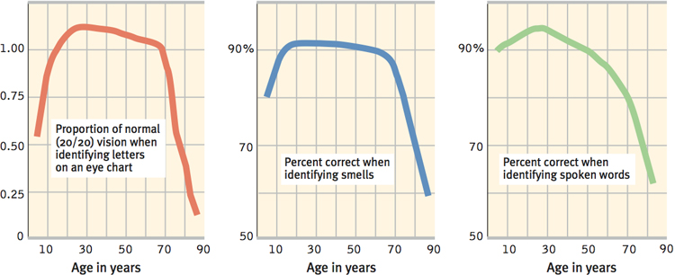
Social Development Adulthood’s Ages and Stages
Midlife transition
Social clock

Slide 60
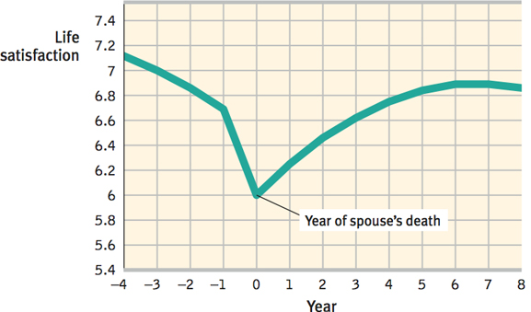
Social Development Adulthood Commitments
Love
Work

Slide 61
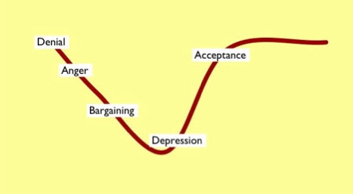
Social Development Well-Being Across the Life Span
Well-being across the life span
Death and dying

Slide 62
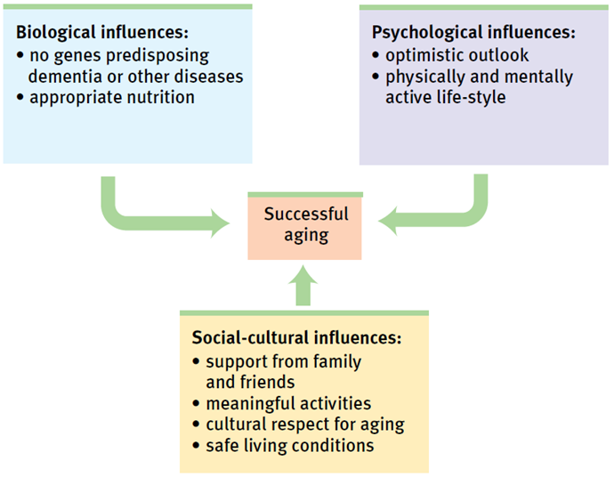
Biopsychosocial Influences on Successful Aging

Slide 63
Reflections on Two Major Developmental Issues

Slide 64
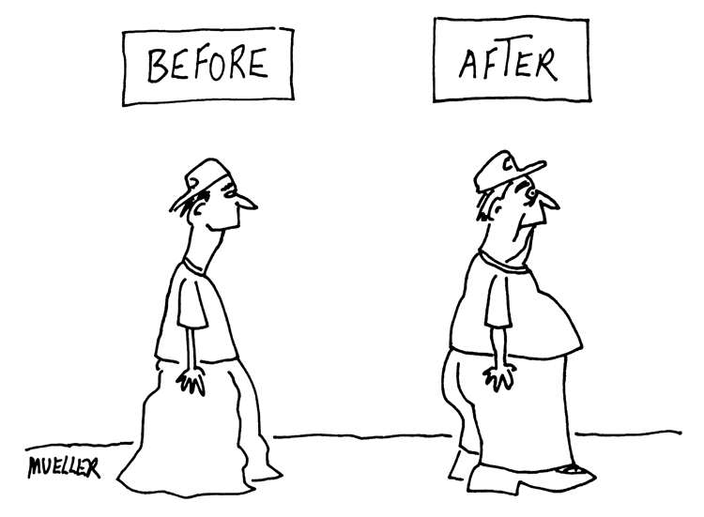
Three Major Developmental Issues
Nature versus nurture
Continuity and stages
Stability and change

Slide 65
Continuity and Stages

Slide 66
The End

Slide 67
Definition Slides

Slide 68
Developmental Psychology
= a branch of psychology that studies physical, cognitive, and social change throughout the life span.

Slide 69
Zygote
= the fertilized egg, it enters a 2-week period of rapid cell division and develops into an embryo.

Slide 70
Embryo
= the developing human organism from about 2 weeks after fertilization through the second month.

Slide 71
Fetus
= the developing human organism from 9 weeks after conception to birth.

Slide 72
Teratogens
= agents, such as chemicals and viruses, that can reach the embryo or fetus during prenatal development and cause harm.

Slide 73
Fetal Alcohol Syndrome (FAS)
= physical and cognitive abnormalities in children caused by a pregnant woman’s heavy drinking. In severe cases, symptoms include noticeable facial misproportions.

Slide 74
Habituation
= decreasing responsiveness with repeated stimulation. As infants gain familiarity with repeated exposure to a visual stimulus, their interest wanes and they look away sooner.

Slide 75
Maturation
= biological growth processes that enable orderly changes in behavior, relatively uninfluenced by experience.

Slide 76
Cognition
= all mental activities associated with thinking, knowing, remembering, and communicating.

Slide 77
Schema
= a concept or framework that organizes and interprets information.

Slide 78
Assimilation
= interpreting our new experiences in terms of our existing schemas.

Slide 79
Accommodation
= adapting our current understandings (schemas) to incorporate new information.

Slide 80
Sensorimotor Stage
= in Piaget’s theory, the stage (from birth to about 2 years of age) during which infants know the world mostly in terms of their sensory impressions and motor activities.

Slide 81
Object Permanence
= the awareness that things continue to exist when not perceived.

Slide 82
Preoperational Stage
= in Piaget’s theory, the stage (from 2 to about 6 or 7 years of age) during which a child learns to use language but does not yet comprehend the mental operations of concrete logic..

Slide 83
Conservation
= the principle (which Piaget believed to be a part of concrete operational reasoning) that properties such as mass, volume, and number remain the same despite changes in the forms of objects.

Slide 84
Egocentrism
= in Piaget’s theory, the preoperational child’s difficulty taking another’s point of view.

Slide 85
Theory of Mind
= people’s ideas about their own and other’s mental states – about their feelings, perceptions, and thoughts, and the behaviors these might predict.

Slide 86
Concrete Operational Stage
= in Piaget’s theory, the stage of cognitive development (from about 6 or 7 to 11 years of age) during which children gain the mental operations that enable them to think logically about concrete events.

Slide 87
Formal Operational Stage
= in Piaget’s theory, the stage of cognitive development (normally beginning about age 12) during which people begin to think logically about abstract concepts.

Slide 88
Autism
= a disorder that appears in childhood and is marked by deficient communication, social interaction, and understanding of other’s states of mind.

Slide 89
Stranger Anxiety
= the fear of strangers that infants commonly display, beginning by about 8 months of age.

Slide 90
Attachment
= an emotional tie with another person; shown in young children by their seeking closeness to the caregiver and showing distress on separation.

Slide 91
Critical Period
= an optimal period shortly after birth when an organism’s exposure to certain stimuli or experiences produces proper development.

Slide 92
Imprinting
= the process by which certain animals form attachments during a critical period very early in life.

Slide 93
Temperament
= a person’s characteristic emotional reactivity and intensity.

Slide 94
Basic Trust
= according to Erik Erikson, a sense that the world is predictable and trustworthy; said to be formed during infancy by appropriate experiences with responsive caregivers.

Slide 95
Self-concept
= our understanding and evaluation of who we are.

Slide 96
Gender
= in psychology, the biologically and socially influenced characteristics by which people define male and female.

Slide 97
Aggression
= physical or verbal behavior intended to hurt someone.

Slide 98
X Chromosome
= the sex chromosome found in both men and women. Females have two X chromosomes; males have one. An X chromosome from each parent produces a female child.

Slide 99
Y Chromosome
=the sex chromosome found only in males. When paired with an X chromosome from the mother, it produces a male child.

Slide 100
Testosterone
= the most important of the male sex hormones. Both males and females have it, but the additional testosterone in males stimulates the growth of the male sex organs in the fetus and the development of the male sex characteristics during puberty.

Slide 101
Role
= a set of expectations (norms) about a social position, defining how those in the position ought to behave.

Slide 102
Gender Role
= a set of unexpected behaviors for males or for females.

Slide 103
Gender Identity
= our sense of being male or female.

Slide 104
Gender Typing
= the acquisition of a traditional masculine or feminine role.

Slide 105
Social Learning Theory
= the theory that we learn social behavior by observing and imitating and by being rewarded or punished.

Slide 106
Adolescence
= the transition period from childhood to adulthood, extending from puberty to independence.

Slide 107
Puberty
= the period of sexual maturation, during which a person becomes capable of reproducing.

Slide 108
Primary Sexual Characteristics
= the body structures (ovaries, testes, and external genitalia) that makes sexual reproduction possible.

Slide 109
Secondary Sex Characteristics
= nonreproductive sexual characteristics, such as female breasts and hips, male voice quality, and body hair.

Slide 110
Menarche
= the first menstrual period.

Slide 111
Identity
= our sense of self; according to Erikson, the adolescent’s task is to solidify a sense of self by testing and integrating various roles.

Slide 112
Social Identify
= the “we” aspect of our self-concept; the part of our answer to “Who am I?” that comes from our group memberships.

Slide 113
Intimacy
= in Erikson’s theory, the ability to form close, loving relationships; a primary developmental task in late adolescence and early adulthood.

Slide 114
Emerging Adulthood
= for some people in modern cultures, a period from the late teens to mid-twenties, bridging the gap between adolescent dependence and full independence and responsible adulthood.

Slide 115
Menopause
= the time of natural cessation of menstruation; also refers to the biological changes a woman experiences as her ability to reproduce declines.

Slide 116
Cross-sectional Study
= a study in which people of different ages are compared with one another.

Slide 117
Longitudinal Study
= research in which the same people are restudied and retested over a long period.

Slide 118
Crystallized Intelligence
= our accumulated knowledge and verbal skills; tends to increase with age.

Slide 119
Fluid Intelligence
= our ability to reason speedily and abstractly; tends to decrease during late adulthood.

Slide 120
Social Clock
= the culturally preferred timing of social events such as marriage, parenthood, and retirement.

